Slide 1


Sequences, Time Series and Streaming Analytics
19
PART IV · DEEP LEARNING AND MODERN AI
CHAPTER 19 · WEEK 12
Data Science — From Foundations to Intelligent Systems
LECTURER
Dr. Mustafa Hameed
THE ISLAMIA UNIVERSITY OF BAHAWALPUR
Bahawalpur, Pakistan
Department of Information Technology · BSIT · Fall 2026
Notes:
Chapter 19: Sequences, Time Series and Streaming Analytics. Part 4 — Deep Learning and Modern AI. Week 12: Time series; text and NLP. Handout pages 122–128.

Slide 2

Where this chapter sits
THE COURSE
PART I
PART II
PART III
PART IV
PART V
PART VI
1
2
3
4
5
6
7
8
9
10
11
12
13
14
15
16
17
18
19
20
21
22
23
24
25
26
27
28
29
30
31
32
Sequences, Time Series and Streaming Analytics
BUILDS ON
USED LATER IN
Ch 5 Describing Data: Centre, Spread and Shape
Ch 23 Data Engineering at Scale
Ch 14 Model Evaluation and Selection
Ch 25 Data Science for the Internet of Things
Ch 15 Feature Engineering and Ensembles
Ch 26 Data Science for Cybersecurity
Ch 27 MLOps: Deployment, Monitoring and Reliability
Data Science · Chapter 19 · Sequences, Time Series and Streaming Analytics
Handout p. 122 2
Notes:
Place the chapter. Before you start: Chapter 5, Chapter 14 (validation strategy) and Chapter 15 (window aggregations). This chapter is the direct bridge into Chapter 25.

Slide 3

What you will be able to do
LEARNING OUTCOMES
By the end of this chapter you will be able to:
1
Decompose a time series into trend, seasonality and residual, and read the decomposition.
2
Build lag, rolling-window and calendar features for a forecasting model.
3
Validate a temporal model correctly, and explain why random splitting is invalid.
4
Distinguish batch from stream processing and describe windowing.
5
Detect concept drift and specify a response.
Data Science · Chapter 19 · Sequences, Time Series and Streaming Analytics
Handout p. 122 3
Notes:
Read these out: they are the chapter's contract with the room. Each click adds one.

Slide 4

Vocabulary for this chapter
KEY TERMS
time series
trend
seasonality
residual
stationarity
lag feature
rolling window
autocorrelation
ARIMA
horizon
walk-forward validation
batch vs stream
tumbling and sliding windows
watermark
concept drift
Each term is defined where it first matters — not here.
Data Science · Chapter 19 · Sequences, Time Series and Streaming Analytics
Handout p. 122 4
Notes:
Do not define these now; they arrive one at a time. This slide is for the students' notes. Terms: time series; trend; seasonality; residual; stationarity; lag feature; rolling window; autocorrelation; ARIMA; horizon; walk-forward validation; batch vs stream; tumbling and sliding windows; watermark; concept drift.

Slide 5
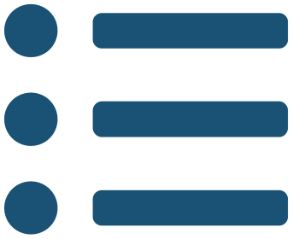
In this chapter
IN THIS CHAPTER
19.1
What Makes Time Different
p. 122 ›
19.2
Decomposition
p. 122 ›
19.3
Features for Forecasting
p. 123 ›
19.4
Validating a Temporal Model
p. 124 ›
19.5
Batch and Stream Processing
p. 124 ›
19.6
Concept Drift
p. 125 ›
Data Science · Chapter 19 · Sequences, Time Series and Streaming Analytics
Handout pp. 122–128 5
Notes:
The route through the chapter. Each row is a link: click it to jump to that section in the slide show.

Slide 6

The Rule That Governs This Whole Chapter
WATCH OUT
Observations are not independent. Today’s value depends on yesterday’s. Every technique in Part III assumed independence, so every one of them needs adjusting here — most importantly the validation strategy. Shuffling a time series destroys the only structure that matters.
Data Science · Chapter 19 · Sequences, Time Series and Streaming Analytics
§19.1 · Handout p. 122 6
Notes:
Read the box aloud, then ask for an example from the room before moving on.

Slide 7
Decomposition
SECTION 2 OF 6
19.2
19.1 What Makes Time Different
19.2 Decomposition
19.3 Features for Forecasting
19.4 Validating a Temporal Model
19.5 Batch and Stream Processing
19.6 Concept Drift
Data Science · Chapter 19
Handout §19.2 7
Notes:
Pause. Name the question this section answers.

Slide 8

Time Series Decomposition
DEFINITION
Any series can be viewed as
(or multiplicatively). Trend is the long-run direction, seasonality is the repeating cycle, and the residual is what is left — which is where anomalies live.
Data Science · Chapter 19 · Sequences, Time Series and Streaming Analytics
§19.2 · Handout p. 122 8
Notes:
Read the box aloud, then ask for an example from the room before moving on.

Slide 9
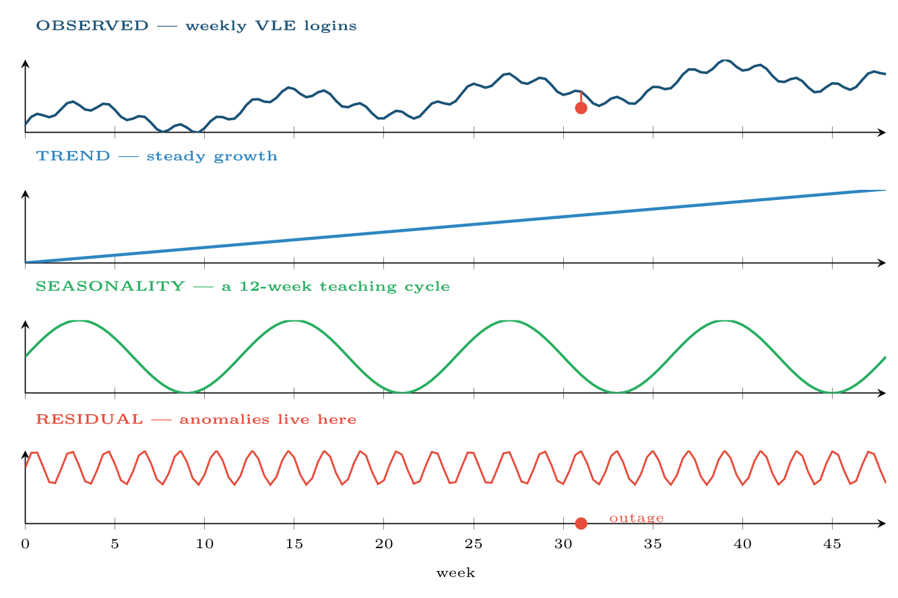
Decomposition of a weekly series
FIGURE 19.1
Separating trend and seasonality is what lets you say whether a drop is alarming: a fall in week 31 means nothing if week 31 always falls, and everything if it does not.
Data Science · Chapter 19 · Sequences, Time Series and Streaming Analytics
§19.2 · Handout p. 122 9
Notes:
Figure 19.1 (handout p. 123): Decomposition of a weekly series. Separating trend and seasonality is what lets you say whether a drop is alarming: a fall in week 31 means nothing if week 31 always falls, and everything if it does not.

Slide 10

Why Decomposition Is the First Step
CONCEPT
“Logins fell 30% this week” is not information until you know whether they fall every year at this point. Decomposition converts a raw number into a statement about the residual — and only the residual is worth alerting on. This is the single most useful idea in operational monitoring.
Data Science · Chapter 19 · Sequences, Time Series and Streaming Analytics
§19.2 · Handout p. 122 10
Notes:
Read the box aloud, then ask for an example from the room before moving on.

Slide 11
Features for Forecasting
SECTION 3 OF 6
19.3
19.1 What Makes Time Different
19.2 Decomposition
19.3 Features for Forecasting
19.4 Validating a Temporal Model
19.5 Batch and Stream Processing
19.6 Concept Drift
Data Science · Chapter 19
Handout §19.3 11
Notes:
Pause. Name the question this section answers.

Slide 12

Features for Forecasting
AT A GLANCE
Feature type | Construction | Captures
Lags | y_{t−1}, y_{t−7}, y_{t−365} | Recent level, last week, last year — pick lags matching known cycles
Rolling statistics | mean, sd, min, max over a window | Local level and volatility
Rolling differences | y_{t} − y_{t−1}; y_{t} / y_{t−7} | Change and growth rate rather than level
Calendar | hour, day of week, month, is_holiday | Human rhythms — essential in security and IoT
Expanding statistics | mean since the start | Long-run baseline for that entity
Time since event | days since last failure / login | Recency, which is often the strongest single feature
Data Science · Chapter 19 · Sequences, Time Series and Streaming Analytics
§19.3 · Handout p. 123 12
Notes:
Do not read the table row by row: pick the row the room is most likely to get wrong and ask why.

Slide 13
Every Lag Must Look Backwards Only
WATCH OUT
A rolling mean centred on t uses y_{t+1}, which will not exist at prediction time. Use trailing windows exclusively. Most time-series leakage is a centred window or a shift() in the wrong direction — and it produces spectacular, entirely fake, validation scores.
Data Science · Chapter 19 · Sequences, Time Series and Streaming Analytics
§19.3 · Handout p. 123 13
Notes:
Read the box aloud, then ask for an example from the room before moving on.

Slide 14
Validating a Temporal Model
SECTION 4 OF 6
19.4
19.1 What Makes Time Different
19.2 Decomposition
19.3 Features for Forecasting
19.4 Validating a Temporal Model
19.5 Batch and Stream Processing
19.6 Concept Drift
Data Science · Chapter 19
Handout §19.4 14
Notes:
Pause. Name the question this section answers.

Slide 15
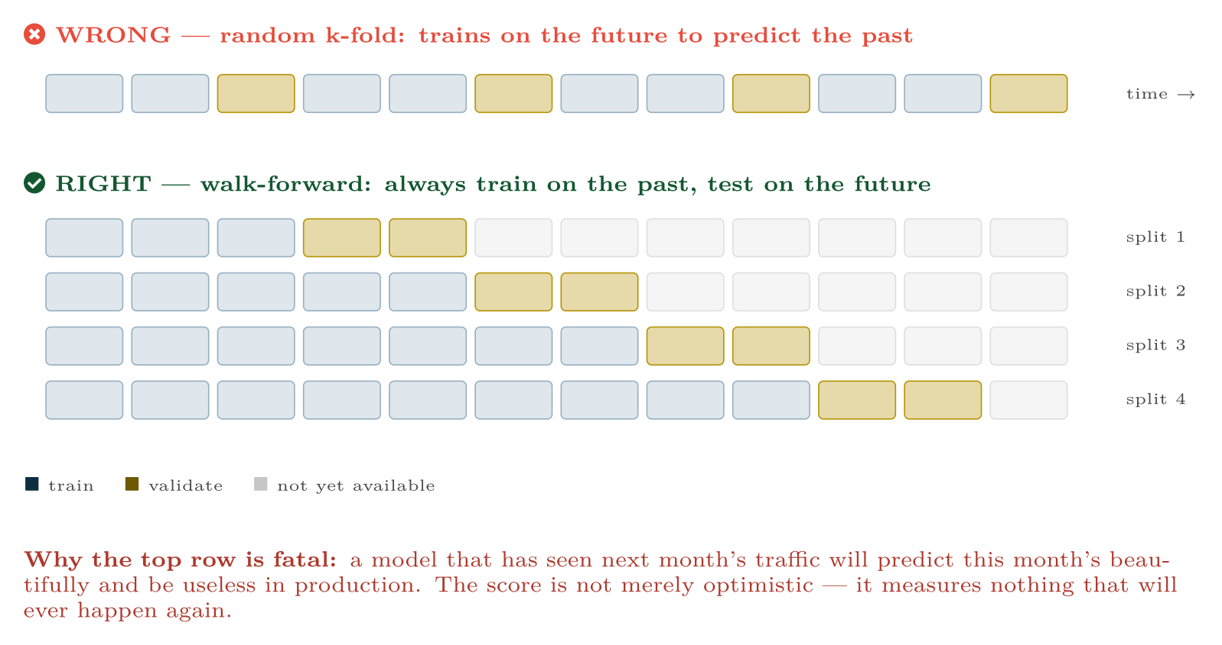
Walk-forward (rolling-origin) validation
FIGURE 19.2
The training window only ever extends backwards; each validation block sits strictly after its training data, exactly as deployment will.
Data Science · Chapter 19 · Sequences, Time Series and Streaming Analytics
§19.4 · Handout p. 124 15
Notes:
Figure 19.2 (handout p. 124): Walk-forward (rolling-origin) validation. The training window only ever extends backwards; each validation block sits strictly after its training data, exactly as deployment will.

Slide 16

Choosing the Forecast Horizon
WORKED EXAMPLE
A university wants to predict weekly VLE logins to size its servers.
The question nobody asks first: how far ahead, and why? The horizon is set by how long the resulting action takes, not by what the model can do.
• Auto-scaling cloud capacity: minutes of lead time needed ⇒ 1-hour horizon.
• Provisioning extra servers: 2 weeks of procurement ⇒ 2-week horizon.
• Budgeting next year’s contract: 12-month horizon.
Why it changes the model. At a 1-hour horizon, y_{t−1} is available and is overwhelmingly the best predictor — a naive “same as last hour” baseline is hard to beat. At a 12-month horizon, no recent lag is available at prediction time, so the model must rely on trend, seasonality and enrolment forecasts, and error will be several times larger.
The consequence for evaluation. A model quoted as “8% error” is meaningless without its horizon. Always report error per horizon, and always compare against the naive baseline at that same horizon — which, at short horizons, is a much stronger competitor than students expect.
Data Science · Chapter 19 · Sequences, Time Series and Streaming Analytics
§19.4 · Handout p. 124 16
Notes:
Each click adds one step of the working. Ask for the next number before you reveal it.

Slide 17
Batch and Stream Processing
SECTION 5 OF 6
19.5
19.1 What Makes Time Different
19.2 Decomposition
19.3 Features for Forecasting
19.4 Validating a Temporal Model
19.5 Batch and Stream Processing
19.6 Concept Drift
Data Science · Chapter 19
Handout §19.5 17
Notes:
Pause. Name the question this section answers.

Slide 18
Batch versus Stream
DEFINITION
Batch processing runs over a bounded, stored dataset — nightly, hourly. Stream processing runs continuously over an unbounded sequence of events, computing results incrementally as data arrives.
Data Science · Chapter 19 · Sequences, Time Series and Streaming Analytics
§19.5 · Handout p. 124 18
Notes:
Read the box aloud, then ask for an example from the room before moving on.

Slide 19
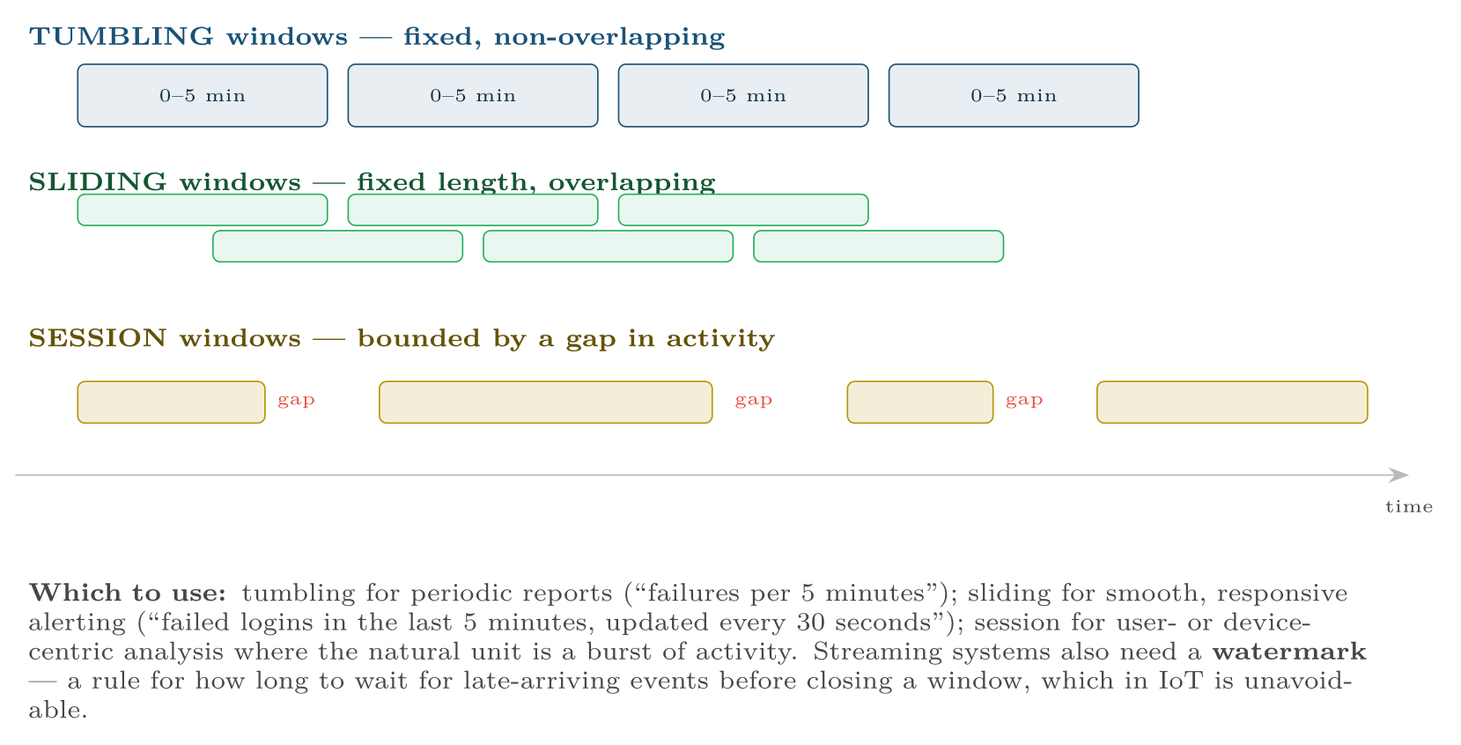
Three windowing strategies for streaming data
FIGURE 19.3
Choosing the window is choosing what “recent” means, and it determines both detection latency and false-alarm rate.
Data Science · Chapter 19 · Sequences, Time Series and Streaming Analytics
§19.5 · Handout p. 124 19
Notes:
Figure 19.3 (handout p. 125): Three windowing strategies for streaming data. Choosing the window is choosing what “recent” means, and it determines both detection latency and false-alarm rate.

Slide 20
Concept Drift
SECTION 6 OF 6
19.6
19.1 What Makes Time Different
19.2 Decomposition
19.3 Features for Forecasting
19.4 Validating a Temporal Model
19.5 Batch and Stream Processing
19.6 Concept Drift
Data Science · Chapter 19
Handout §19.6 20
Notes:
Pause. Name the question this section answers.

Slide 21
Concept Drift
DEFINITION
The relationship between features and target changes over time, so a model that was correct becomes wrong without anything breaking. Data drift is a change in the inputs’ distribution; concept drift is a change in the mapping itself.
Data Science · Chapter 19 · Sequences, Time Series and Streaming Analytics
§19.6 · Handout p. 125 21
Notes:
Read the box aloud, then ask for an example from the room before moving on.

Slide 22
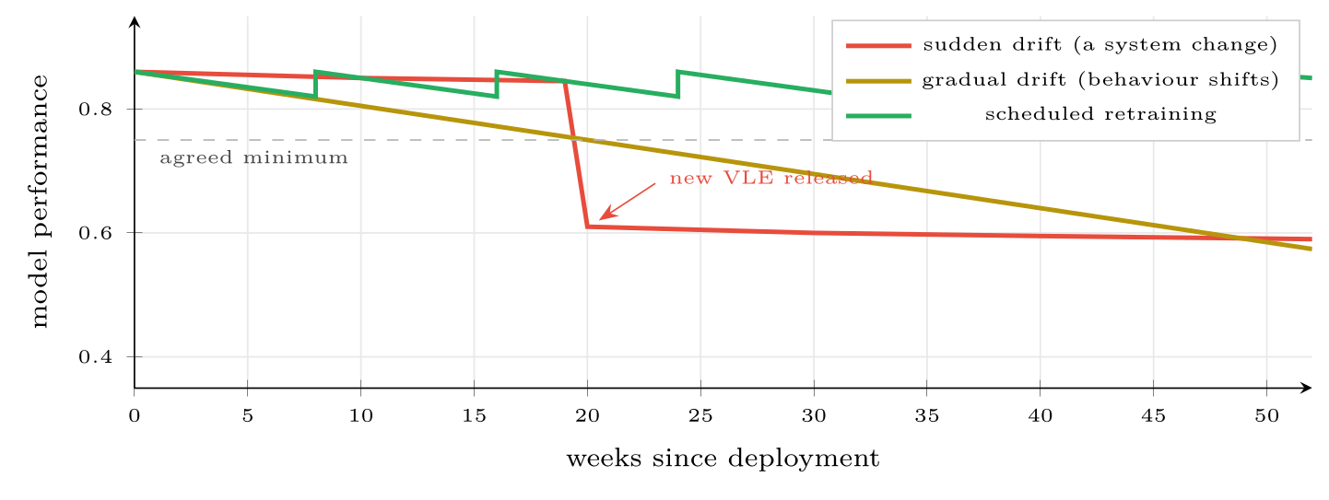
Three fates of a deployed model
FIGURE 19.4
Nothing about the code changed in any of them — the world did. Monitoring for this is the subject of Chapter 27.
Data Science · Chapter 19 · Sequences, Time Series and Streaming Analytics
§19.6 · Handout p. 125 22
Notes:
Figure 19.4 (handout p. 125): Three fates of a deployed model. Nothing about the code changed in any of them — the world did. Monitoring for this is the subject of Chapter 27.

Slide 23
Concept Drift
AT A GLANCE
Drift type | Looks like | Response
Sudden | A cliff in the performance chart | Investigate the cause first — usually an upstream change, not the model
Gradual | Slow decline over months | Scheduled retraining on a rolling window
Seasonal / recurring | Performance dips at the same point each cycle | Add the seasonal feature; do not retrain away a pattern you can model
Adversarial | Decline that accelerates after deployment | The attacker is adapting (Chapter 26); retraining alone will not fix it
Data Science · Chapter 19 · Sequences, Time Series and Streaming Analytics
§19.6 · Handout p. 125 23
Notes:
Do not read the table row by row: pick the row the room is most likely to get wrong and ask why.

Slide 24





Four lenses: Time and Streams
FOUR LENSES
LEARNING ANALYTICS
PROJECT MANAGEMENT
Engagement is strongly seasonal on a weekly and a semester cycle — always decompose before alerting, or you will raise an alarm every reading week.
Sprint data is a short, irregular series with strong autocorrelation — this sprint resembles the last.
INTERNET OF THINGS
CYBERSECURITY
This chapter is the technical bridge to Chapter 25.
Windowed counts are the core feature type: failed logins per account per 5 minutes, distinct ports per host per minute.
Data Science · Chapter 19 · Sequences, Time Series and Streaming Analytics
Handout p. 128 24
Notes:
The same method, four domains. Each of the next four slides opens one lens in full.

Slide 25

Learning Analytics: Time and Streams
FOUR LENSES
LEARNING ANALYTICS
Project Management
Engagement is strongly seasonal on a weekly and a semester cycle — always decompose before alerting, or you will raise an alarm every reading week. The trajectory of a student’s residual is the signal: two consecutive weeks below their own baseline is a far better trigger than any absolute threshold. Validation must be walk-forward across cohorts, since a model trained on the 2025 cohort to predict 2024 proves nothing.
Internet of Things
Cybersecurity
Data Science · Chapter 19 · Sequences, Time Series and Streaming Analytics
Handout p. 128 25
Notes:
Learning Analytics. Engagement is strongly seasonal on a weekly and a semester cycle — always decompose before alerting, or you will raise an alarm every reading week. The trajectory of a student’s residual is the signal: two consecutive weeks below their own baseline is a far better trigger than any absolute threshold. Validation must be walk-forward across cohorts, since a model trained on the 2025 cohort to predict 2024 proves nothing.

Slide 26

Project Management: Time and Streams
FOUR LENSES
PROJECT MANAGEMENT
Learning Analytics
Sprint data is a short, irregular series with strong autocorrelation — this sprint resembles the last. The naive baseline (“same as last sprint”) is genuinely hard to beat, and saying so honestly is more valuable than a marginally better model. Concept drift is guaranteed whenever the team composition changes, which is why models here need a shorter memory than elsewhere.
Internet of Things
Cybersecurity
Data Science · Chapter 19 · Sequences, Time Series and Streaming Analytics
Handout p. 128 26
Notes:
Project Management. Sprint data is a short, irregular series with strong autocorrelation — this sprint resembles the last. The naive baseline (“same as last sprint”) is genuinely hard to beat, and saying so honestly is more valuable than a marginally better model. Concept drift is guaranteed whenever the team composition changes, which is why models here need a shorter memory than elsewhere.

Slide 27

Internet of Things: Time and Streams
FOUR LENSES
INTERNET OF THINGS
Learning Analytics
This chapter is the technical bridge to Chapter 25. Telemetry is the purest streaming problem: unbounded, high-volume, out-of-order. Use sliding windows for detection latency, tumbling for reporting, and set the watermark from the worst-case network delay in your fleet. Sensors drift physically as well as statistically — a thermistor ages — so drift monitoring must distinguish a failing sensor from a changing process.
Project Management
Cybersecurity
Data Science · Chapter 19 · Sequences, Time Series and Streaming Analytics
Handout p. 128 27
Notes:
Internet of Things. This chapter is the technical bridge to Chapter 25. Telemetry is the purest streaming problem: unbounded, high-volume, out-of-order. Use sliding windows for detection latency, tumbling for reporting, and set the watermark from the worst-case network delay in your fleet. Sensors drift physically as well as statistically — a thermistor ages — so drift monitoring must distinguish a failing sensor from a changing process.

Slide 28

Cybersecurity: Time and Streams
FOUR LENSES
CYBERSECURITY
Learning Analytics
Windowed counts are the core feature type: failed logins per account per 5 minutes, distinct ports per host per minute. Diurnal and weekly seasonality is strong, so a 3 a.m. spike matters and a 3 p.m. one may not — decompose first. Drift here is adversarial, which makes it categorically different from the other three lenses: the distribution is not shifting by accident, it is being shifted deliberately, and scheduled retraining on recent data can be poisoned.
Project Management
Internet of Things
Data Science · Chapter 19 · Sequences, Time Series and Streaming Analytics
Handout p. 128 28
Notes:
Cybersecurity. Windowed counts are the core feature type: failed logins per account per 5 minutes, distinct ports per host per minute. Diurnal and weekly seasonality is strong, so a 3 a.m. spike matters and a 3 p.m. one may not — decompose first. Drift here is adversarial, which makes it categorically different from the other three lenses: the distribution is not shifting by accident, it is being shifted deliberately, and scheduled retraining on recent data can be poisoned.

Slide 29

Try it yourself: Decompose, Feature, Validate
TRY IT YOURSELF
WHAT YOU WILL DO
1. Decompose before doing anything else
2. Features -- every one looks BACKWARDS only
3. Walk-forward validation, never random
4. A simple drift monitor
THIS WEEK'S LAB
WHAT YOU WILL RUN
Week 12: Decompose & walk-forward; TF-IDF classifier
1 listing, 39 lines of Python
Data Science · Chapter 19 · Sequences, Time Series and Streaming Analytics
§19.6 · Handout p. 125 29
Notes:
Say what the room will have at the end of the lab, then let them start. Circulate rather than lecture.

Slide 30
Decompose, Feature, Validate
LAB · STEP 1 OF 5
Set-up
Python
1
2
3
4
5
6
7
import pandas as pd, numpy as np
from statsmodels.tsa.seasonal import seasonal_decompose
from sklearn.model_selection import TimeSeriesSplit
from sklearn.ensemble import HistGradientBoostingRegressor
from sklearn.metrics import mean_absolute_error
s = df.set_index("date")["logins"].asfreq("W")
Data Science · Chapter 19 · Sequences, Time Series and Streaming Analytics
§19.6 · Handout p. 125 30
Notes:
Step 1: Set-up. Read the code aloud; ask what each line would print before running it.

Slide 31
Decompose, Feature, Validate
LAB · STEP 2 OF 5
Decompose before doing anything else
Python
8
9
# --- 1. decompose before doing anything else --------------------------
seasonal_decompose(s, model="additive", period=12).plot()
Data Science · Chapter 19 · Sequences, Time Series and Streaming Analytics
§19.6 · Handout p. 125 31
Notes:
Step 2: Decompose before doing anything else. Read the code aloud; ask what each line would print before running it.

Slide 32
Decompose, Feature, Validate
LAB · STEP 3 OF 5
Features -- every one looks BACKWARDS only
Python
10
11
12
13
14
15
16
17
18
19
20
# --- 2. features -- every one looks BACKWARDS only --------------------
X = pd.DataFrame(index=s.index)
for lag in (1, 2, 4, 12, 52):
X[f"lag{lag}"] = s.shift(lag) # shift(+n) = past. Never shift(-n).
X["roll4_mean"] = s.shift(1).rolling(4).mean() # shift(1) FIRST, then roll
X["roll4_std"] = s.shift(1).rolling(4).std()
X["delta1"] = s.shift(1) - s.shift(2)
X["week"] = X.index.isocalendar().week.astype(int)
X["month"] = X.index.month
y = s
X, y = X.dropna(), y.loc[X.dropna().index]
Data Science · Chapter 19 · Sequences, Time Series and Streaming Analytics
§19.6 · Handout p. 125 32
Notes:
Step 3: Features -- every one looks BACKWARDS only. Read the code aloud; ask what each line would print before running it.

Slide 33
Decompose, Feature, Validate
LAB · STEP 4 OF 5
Walk-forward validation, never random
Python
21
22
23
24
25
26
27
28
29
30
31
# --- 3. walk-forward validation, never random -------------------------
tscv = TimeSeriesSplit(n_splits=5)
naive_errs, model_errs = [], []
for tr, te in tscv.split(X):
m = HistGradientBoostingRegressor().fit(X.iloc[tr], y.iloc[tr])
model_errs.append(mean_absolute_error(y.iloc[te], m.predict(X.iloc[te])))
naive_errs.append(mean_absolute_error(y.iloc[te], X.iloc[te]["lag1"]))
print(f"naive (last value) MAE : {np.mean(naive_errs):.2f}")
print(f"model MAE : {np.mean(model_errs):.2f}")
# If the model does not clearly beat naive, the extra complexity is not earning its keep.
Data Science · Chapter 19 · Sequences, Time Series and Streaming Analytics
§19.6 · Handout p. 125 33
Notes:
Step 4: Walk-forward validation, never random. Read the code aloud; ask what each line would print before running it.

Slide 34
Decompose, Feature, Validate
LAB · STEP 5 OF 5
A simple drift monitor
Python
32
33
34
35
# --- 4. a simple drift monitor ----------------------------------------
recent, reference = model_errs[-1], np.mean(model_errs[:-1])
if recent > 1.5 * reference:
print("DRIFT ALERT: recent error is 50% above the reference window")
Data Science · Chapter 19 · Sequences, Time Series and Streaming Analytics
§19.6 · Handout p. 125 34
Notes:
Step 5: A simple drift monitor. Read the code aloud; ask what each line would print before running it.

Slide 35

Why is rolling(7, center=True) a leakage bug in a forecasting feature?
CHECKPOINT 1 OF 3
Discuss with the person next to you, then advance.
Data Science · Chapter 19 · Sequences, Time Series and Streaming Analytics
Handout p. 128 · answers in Appendix D 35
Notes:
Ask the room. Do not advance until someone commits to an answer.

Slide 36

Why is rolling(7, center=True) a leakage bug in a forecasting feature?
CHECKPOINT 1 OF 3 · ANSWER
A centred window includes values after time t, which will not exist when the model runs. The feature encodes the future, so validation scores are inflated and production performance collapses.
Data Science · Chapter 19 · Sequences, Time Series and Streaming Analytics
Handout p. 128 · answers in Appendix D 36
Notes:
Answer (Appendix D): A centred window includes values after time t, which will not exist when the model runs. The feature encodes the future, so validation scores are inflated and production performance collapses.

Slide 37
Traffic drops 40% on 25 December. Is this an anomaly? What must you compute before answering?
CHECKPOINT 2 OF 3
Discuss with the person next to you, then advance.
Data Science · Chapter 19 · Sequences, Time Series and Streaming Analytics
Handout p. 128 · answers in Appendix D 37
Notes:
Ask the room. Do not advance until someone commits to an answer.

Slide 38
Traffic drops 40% on 25 December. Is this an anomaly? What must you compute before answering?
CHECKPOINT 2 OF 3 · ANSWER
Not necessarily. Decompose first: if traffic drops every 25 December, the seasonal component accounts for it and the residual is unremarkable. Only a drop beyond the expected seasonal pattern is an anomaly.
Data Science · Chapter 19 · Sequences, Time Series and Streaming Analytics
Handout p. 128 · answers in Appendix D 38
Notes:
Answer (Appendix D): Not necessarily. Decompose first: if traffic drops every 25 December, the seasonal component accounts for it and the residual is unremarkable. Only a drop beyond the expected seasonal pattern is an anomaly.

Slide 39
A model’s accuracy fell from 0.87 to 0.62 in one week with no code change. What are the first two things you check?
CHECKPOINT 3 OF 3
Discuss with the person next to you, then advance.
Data Science · Chapter 19 · Sequences, Time Series and Streaming Analytics
Handout p. 128 · answers in Appendix D 39
Notes:
Ask the room. Do not advance until someone commits to an answer.

Slide 40
A model’s accuracy fell from 0.87 to 0.62 in one week with no code change. What are the first two things you check?
CHECKPOINT 3 OF 3 · ANSWER
(i) Did an upstream data source change or break — check input distributions and row counts. (ii) Did the world change — a new system, a policy change, a new attacker technique. A sudden cliff is almost always an upstream change rather than gradual model decay.
Data Science · Chapter 19 · Sequences, Time Series and Streaming Analytics
Handout p. 128 · answers in Appendix D 40
Notes:
Answer (Appendix D): (i) Did an upstream data source change or break — check input distributions and row counts. (ii) Did the world change — a new system, a policy change, a new attacker technique. A sudden cliff is almost always an upstream change rather than gradual model decay.

Slide 41

What to take away
CHAPTER SUMMARY
1
Temporal observations are dependent, so the independence assumption behind Part III does not hold — most importantly for validation.
2
Decompose into trend, seasonality and residual; alert on the residual, not the raw value.
3
Build lag, rolling, difference and calendar features, all strictly backward-looking.
4
Validate walk-forward. Random k-fold on a time series trains on the future and produces meaningless scores.
5
The forecast horizon is set by the lead time of the action it supports, and error must be reported per horizon against the naive baseline.
6
Streams need windows — tumbling, sliding or session — plus a watermark for late data.
7
Concept drift degrades deployed models silently. Monitor, and distinguish gradual, sudden, seasonal and adversarial drift.
Data Science · Chapter 19 · Sequences, Time Series and Streaming Analytics
Handout p. 128 41
Notes:
Ask the room to say each takeaway before you reveal it.

Slide 42

Quick check 1 of 2
REVIEW · MULTIPLE CHOICE
The correct validation scheme for a forecasting model is:
A
random k-fold
B
stratified k-fold
C
walk-forward
D
leave-one-out
Data Science · Chapter 19 · Sequences, Time Series and Streaming Analytics
Handout p. 128 42
Notes:
Take a show of hands for each option before discussing. (The handout does not print MCQ answers.)

Slide 43
Quick check 2 of 2
REVIEW · MULTIPLE CHOICE
Windows that are fixed-length and non-overlapping are called:
A
sliding
B
tumbling
C
session
D
expanding
Data Science · Chapter 19 · Sequences, Time Series and Streaming Analytics
Handout p. 128 43
Notes:
Take a show of hands for each option before discussing. (The handout does not print MCQ answers.)

Slide 44
For your notebook
REVIEW QUESTIONS
SHORT
Define concept drift and distinguish it from data drift.
SHORT
Why is the naive “last value” baseline so strong at short horizons, and what does that imply for how you report results?
SHORT
What is a watermark in stream processing and why does IoT need one?
APPLIED
You must alert on unusual failed-login volume per account. Specify the window type and length, the decomposition you would apply, and the threshold rule — and justify each against the base-rate argument of Chapter 6.
APPLIED
A deployed predictive-maintenance model degrades steadily over eight months. List four possible causes spanning sensors, process and model, and state the diagnostic that would distinguish them.
Data Science · Chapter 19 · Sequences, Time Series and Streaming Analytics
Handout p. 128 44
Notes:
Set these for independent study. Model answers are not printed in the handout.

Slide 45
End of Chapter 19
19
NEXT
READ
Chapter 20 — Text and Natural Language Processing
Handout Chapter 19, pages 122–128
THIS WEEK'S LAB
ASSESSMENT
Decompose & walk-forward; TF-IDF classifier
Assignment 2 due
Data Science · Chapter 19 · Sequences, Time Series and Streaming Analytics
45
Notes:
Close. NEXT: Chapter 20 — Text and Natural Language Processing. READ: Handout Chapter 19, pages 122–128. THIS WEEK'S LAB: Decompose & walk-forward; TF-IDF classifier. ASSESSMENT: Assignment 2 due.

